Slide 1
Long Term Hospitalizations Analysis Based on Potential Nosocomial Infections and Other Risk Factors
Hayoung Cheon Solomon Mathews Payden Bullis

Slide 2
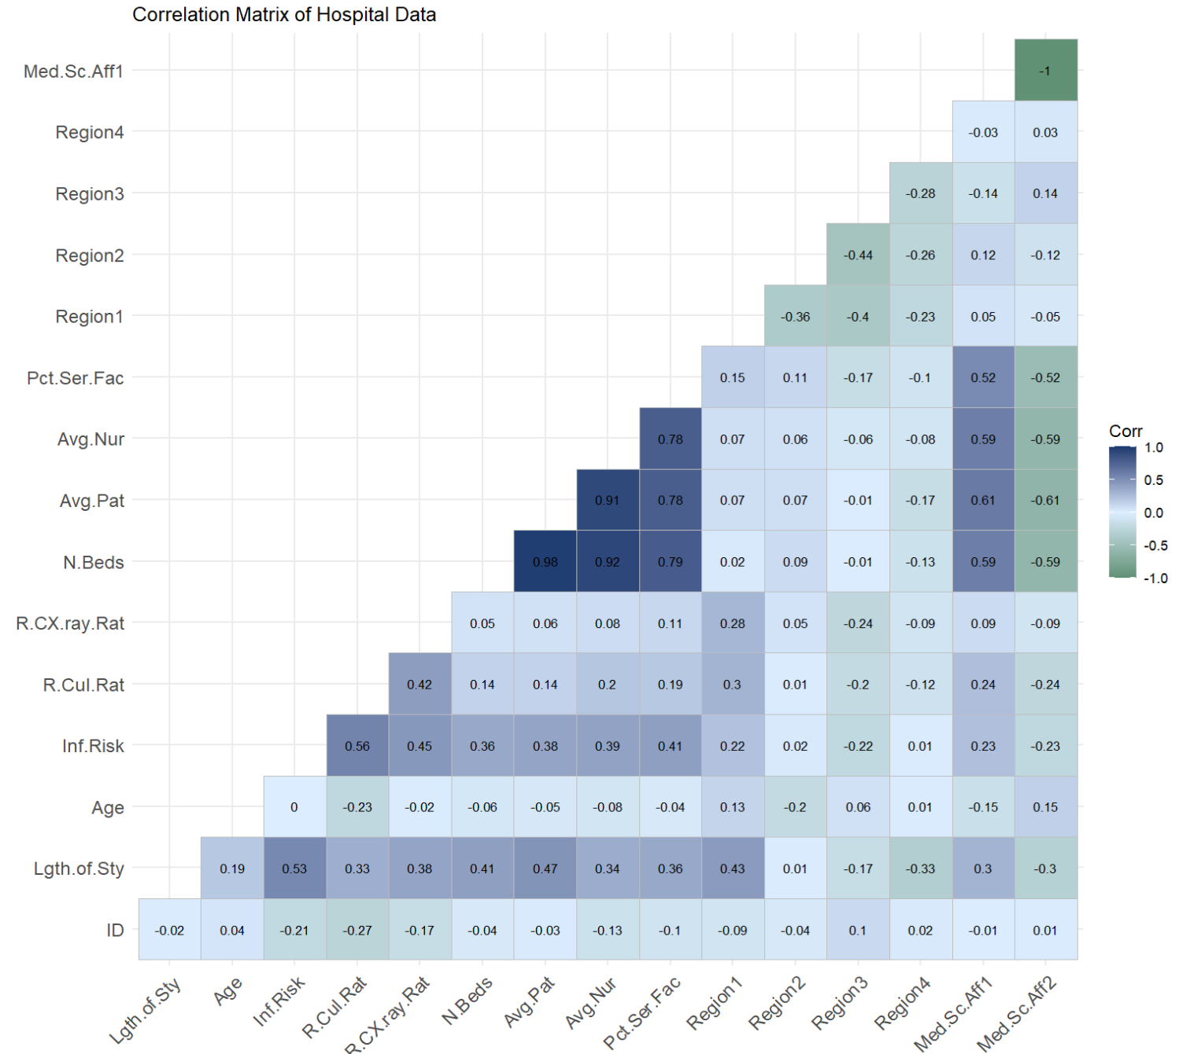
EDA and Summary Information
114 observations.
No missing data.
12 variables
9 numerical
2 Categorical (except ID)
Observational Data and not randomly sampled
No causal inferences can be gained.

Slide 3
Define variables
Length of Stay
Hospital ID
Age
Average length of stay (in days)
Identification of a single hospital from the data
Average age of patients (years)
Infection Risk
Routine Culturing Ratio
Routine Chest X-ray Ratio
Average estimated probability of hospital infection
Ratio of # of cultures performed to number of patients without symptoms of infection times 100
Ratio of # of cultures performed to number of patients without symptoms of pneumonia time 100
Notes:
“We are defining the Routine Culturing Ratio and the Routine Chest Xray variables as the number of test per 100 patients, this could be either due to policy, best practice, or “as indicated” by patience risk factors and underlying conditions.” These metrics are commonly used to determine ‘nosocomial’ rates.
nosocomial is a disease originating in a hospital.

Slide 4
Define variables
C
Number of Beds
Medical School Affiliation
Average Daily Census
Average number of beds in the hospital
Whether or not the hospital is associated with a medical school
Average number of patients in hospital per day
C
Number of Nurses
Region
Available Facilities
Average number of full-time nurses
Geographic region Northeast, North Central, South, West
Percent of 35 potential facilities and services that are provided by the hospital
Notes:
Cover these topics quickly, no need to read off the exact text from the boxes. Geography, region isn’t defined but probably clear with regard to typical understanding of how the US is generally divided. List of potential Facilities you can read off a few of these not the entire list. Emergency Care 2. Surgery 3. Maternity Care 4. Pediatrics 5. Cardiology 6. Oncology 7. Neurology 8. Orthopedics 9. Gastroenterology 10. Dermatology 11. Psychiatry 12. Radiology 13. Pathology 14. Anesthesiology 15. Intensive Care Unit (ICU) 16. Rehabilitation Services 17. Physical Therapy 18. Occupational Therapy 19. Speech Therapy 20. Pharmacy 21. Laboratory Services 22. Outpatient Department (OPD) 23. Ward Facilities 24. Nursing Services 25. Medical Imaging (MRI, CT scans) 26. Dialysis 27. Palliative Care 28. Urgent Care 29. Endoscopy 30. Vascular Surgery 31. Plastic Surgery 32. Gynecology 33. Pulmonology 34. ENT (Ear, Nose, and Throat) 35. Specialty Clinics (e.g., diabetes, hypertension)

Slide 5
EDA and Summary Information
Number of Beds
Coefficient: -0.004851 P_{value} : 0.065222
Routine Chest X-ray Ratio
Coefficient: 0.012688 P_{value} : 0.078892
Infection Risk
Coefficient: 0.439665 P_{value} : 0.000812
Routine Culturing Ratio
Coefficient: 0.005546 P_{value} : 0.729299
Average Daily Census
Coefficient: 0.015182 P_{value} : 0.000872
Number of Nurses
Coefficient: -0.005891 P_{value} : 0.009203
Age
Coefficient: 0.079922 P_{value} : 0.005668
Services Provided
Coefficient: -0.012179 P_{value} : 0.378698

Slide 6
EDA and Summary Information
Medical School Affiliation: no
Coefficient: -0.266644 P_{value} : 0.546872
Region 2 NC
Coefficient: -0.812966 P_{value} : 0.022744
Region 3 S
Coefficient: -1.158277 P_{value} : 0.001370
Region 4 W
Coefficient: -1.880560 P_{value} : 0.000051

Slide 7
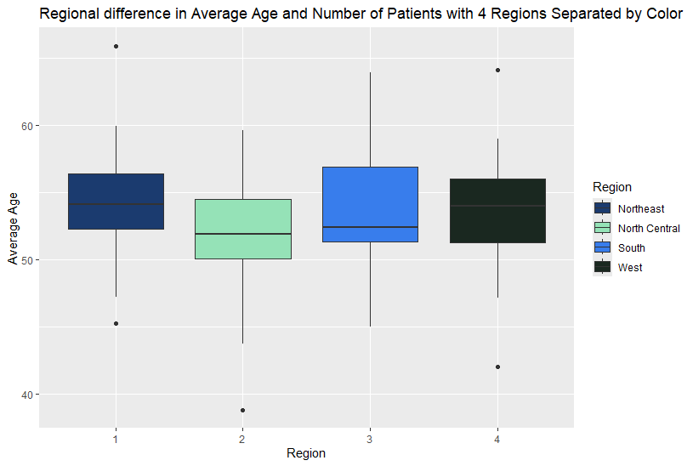
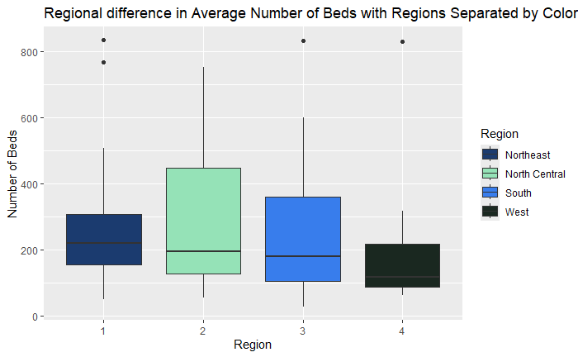
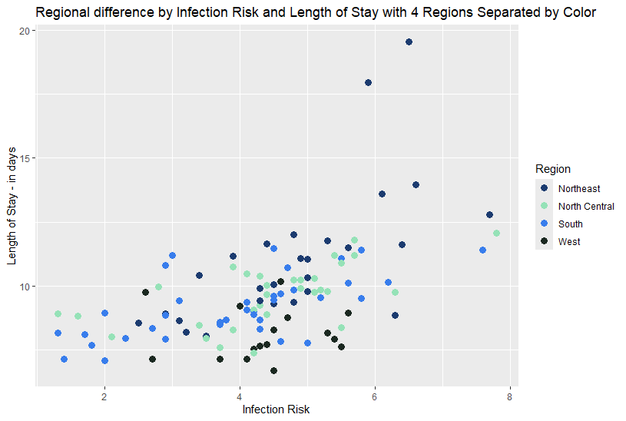
Regional Differences - EDA

Slide 8
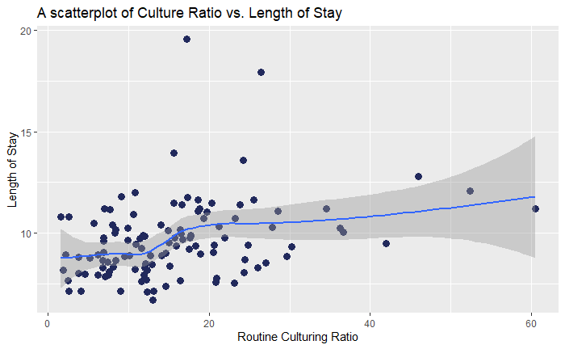
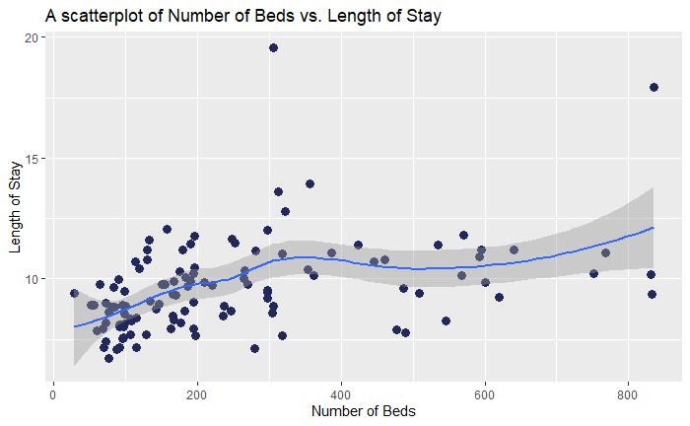
Data Assumptions Exploration

Slide 9
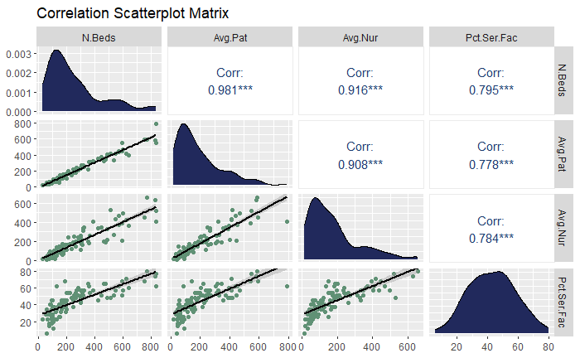
Correlation Matrix with potential Multicollinearity
Notes:
Reviewing the scatter plots for the variables it appears that there are several variables that display some degree of multicollinearity and will need to be addressed during model building.

Slide 11
Objective One
What factors could potentially extend a patient’s stay?
Based on the project instruction this section will review 3 variables
Infection Risk
Chest Xray
Culture ratio
Keeping other variables constant do these factors influence the average patient stay length?
Notes:
For the first objective this model seeks to determine if the infection risk, routine culture rate and routine chest xray are associated with a patients length of stay in a hospital

Slide 12
Objective 1 Summary Table
Routine Chest X-ray Ratio
Coefficient: 0.012688 P_{value} : 0.078892
Infection Risk
Coefficient: 0.439665 P_{value} : 0.000812
0.000812
Routine Culturing Ratio
Coefficient: 0.005546 P_{value} : 0.729299
Number of Beds
Coefficient: -0.004851 P_{value} : 0.065222
Average Daily Census
Coefficient: 0.015182 P_{value} : 0.000872
Number of Nurses
Coefficient: -0.005891 P_{value} : 0.009203
Age
Coefficient: 0.079922 P_{value} : 0.005668
Services Provided
Coefficient: -0.012179 P_{value} : 0.378698
Notes:
Payden: I did test logging the cultures and xray variables and it did not improve the P values.

Slide 13
Objective 1 Summary Table
Medical School Affiliation: no
Coefficient: -0.266644 P_{value} : 0.546872
Region 1 NC
Coefficient: -0.812966 P_{value} : 0.022744
Region 2 S
Coefficient: -1.158277 P_{value} : 0.001370
Region 3 W
Coefficient: -1.880560 P_{value} : 0.000051
Notes:
Same data so I am hiding it but keeping it for the info. No need to show the values since they are same as EDA

Slide 14
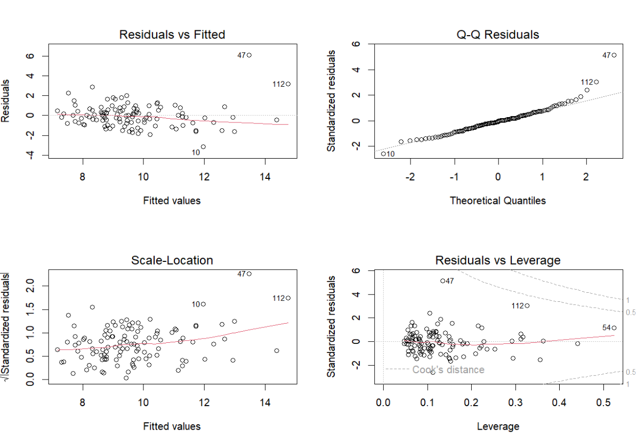
Assumptions
Assumptions and potential issues with the data.
Normalization: Q-Q plot -> normally distributed. Cook’s distance -> outliers remain within the threshold, no leverage
Constant Variance: Residuals vs. fitted: evenly dispersed around the read reference line at zero. No funnel shape.
Independence: For the purpose of the model and fit, these observations will be considered independent.
Notes:
There is a potential for a number factors that could be clustered such as region, though these are large geographic areas so can assume independance

Slide 15
Objective One -Conclusion
Infection risk: For every 2.2774 units of increase in infection risk probability, there is an average expected increase in a patients stay of 1 addition day, holding the other variables fixed.(p-value < 0.05
(Routine culturing Ratio: This variable did not prove to be statistically significant holding other variables constant. (p-value > 0.05)
Routine chest X-ray ratio: This variable did not prove to be statistically significant holding other variables constant. (p-value > 0.05)
RMSE: 1.277319 | Rsquared: 0.5702117 | MAE: 0.9660627
Notes:
Doctors could be bias in their decision to test. or possibly over sample the patient population (this could also be mitigated by insurance costs.) outside the scope of this data.

Slide 16
Objective 2
Further instructions were to build a predictive mode, to predict patient stay length.
2 additional models will be built based on the dataset.
One non-parametric (KNN)
One MLR model with possibility to transform and add interaction terms.

Slide 17
Objective 2 – Complexity
In the data analysis phase we reviewed several of the terms for variable inflation factor, significance and others.
We transformed several variables including – Routine Culture Ratio, and Number of Beds.

Slide 18
Model Building
Number of Beds
35.72693
VIF: 35.72693
Yes - included in predictive model. Log transformed
Routine Chest X-ray Ratio
VIF: 1.418264
Yes - included in predictive model.
Medical School Affiliation
VIF: 1.867108
Yes - included in predictive model.
Infection Risk
VIF: 2.159012
Yes - included in predictive model.
Routine Culturing Ratio
VIF: 1.418264
Yes - included in predictive model. Log transformed
Age
VIF: 1.176754
Yes - included in predictive model.
Average Daily Census
VIF: 34.36364
No – due to multicollinearity
34.36364
Number of Nurses
7.418642
VIF: 7.418642
No – due to multicollinearity
Region
VIF: .721747
Yes - included in predictive model.
Services Provided
VIF: 3.244109
Yes - included in predictive model.

Slide 19
Objective 2
K fold validation – 5 was used due to size of data set.
Most of the variables demonstrated significance during EDA
Multicollinearity was monitored and addressed during build process with final VIFs of factors used being under 5.
Using the Lasso technique we found that these feature were all important to the model and it’s predictive utility.
MSRE: 0.1220263 | Rsquared: 0.5536642 | MAE: 0.09391466
AIC: -154.9845 BIC: -122.2558

Slide 20
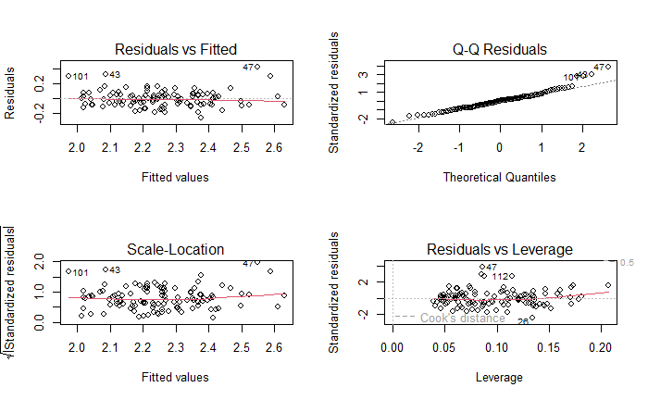
Residual Plot – Complex MLR
Assumptions and potential issues with the data.
Normalization: Q-Q plot -> normally distributed. Cook’s distance -> outliers remain within the threshold, no leverage
Constant Variance: Residuals vs. fitted: evenly dispersed around the read reference line at zero. No funnel shape.
Independence: For the purpose of the model and fit, these observations will be considered independent.

Slide 21
Objective 2 - KNN
KNN model and details such as k term and other considerations. Summary of how the knn was built
“RMSE was used to select the optimal model using the smallest value.”
“The final value used for the model was k = 25.”
MSRE: 1.664686 | Rsquared: 0.2682736 | MAE:1.159992

Slide 22
Objective Two - conclusions
3 models KNN and complex MLR, and simple MLR
Which is best?
Based on the data and models we tested the data appeared largely linear.
The data was largely parametric in nature.
As a result for predictive purpose the MLR model would be recommended due to it lower RMSE.
Model | RMSE
Simple MLR | 1.277319
Complex MLR | 0.1220263
KNN | 1.664686

Slide 23
Instructions for use
If you have a free account, in order to use this template, you must credit Slidesgo by keeping the Thanks slide. Please refer to the next slide to read the instructions for premium users.
As a Free user, you are allowed to:
Modify this template.
Use it for both personal and commercial projects.
You are not allowed to:
Sublicense, sell or rent any of Slidesgo Content (or a modified version of Slidesgo Content).
Distribute Slidesgo Content unless it has been expressly authorized by Slidesgo.
Include Slidesgo Content in an online or offline database or file.
Offer Slidesgo templates (or modified versions of Slidesgo templates) for download.
Acquire the copyright of Slidesgo Content.
For more information about editing slides, please read our FAQs or visit Slidesgo School:
https://slidesgo.com/faqs and https://slidesgo.com/slidesgo-school

Slide 24
Instructions for use (premium users)
As a Premium user, you can use this template without attributing Slidesgo or keeping the "Thanks" slide.
You are allowed to:
Modify this template.
Use it for both personal and commercial purposes.
Hide or delete the “Thanks” slide and the mention to Slidesgo in the credits.
Share this template in an editable format with people who are not part of your team.
You are not allowed to:
Sublicense, sell or rent this Slidesgo Template (or a modified version of this Slidesgo Template).
Distribute this Slidesgo Template (or a modified version of this Slidesgo Template) or include it in a database or in any other product or service that offers downloadable images, icons or presentations that may be subject to distribution or resale.
Use any of the elements that are part of this Slidesgo Template in an isolated and separated way from this Template.
Register any of the elements that are part of this template as a trademark or logo, or register it as a work in an intellectual property registry or similar.
For more information about editing slides, please read our FAQs or visit Slidesgo School:
https://slidesgo.com/faqs and https://slidesgo.com/slidesgo-school

Slide 25


